Slide 1
Understanding Data Collection and Coastal Monitoring

Slide 2
WHAT IS A RESILIENT COMMUNITY?
In this lesson, you will learn how healthy wetlands support resilient communities.
To be resilient means to be able to withstand or recover from change.

Slide 3
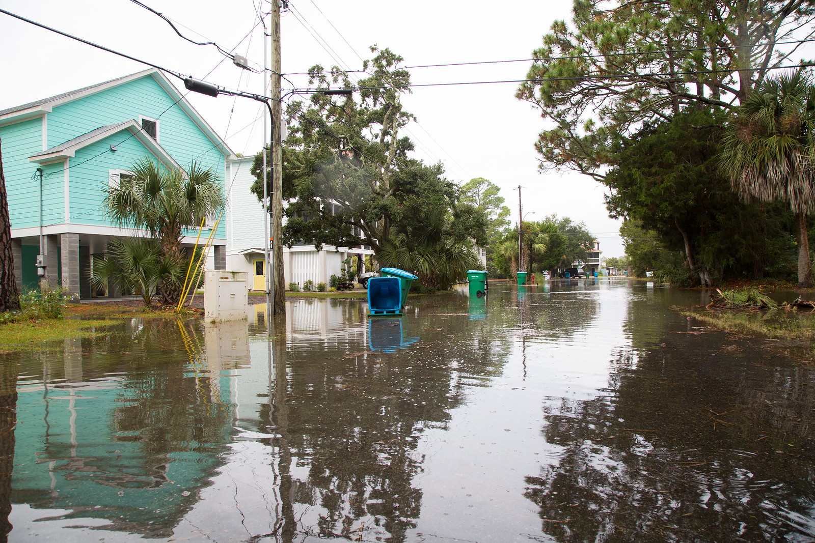
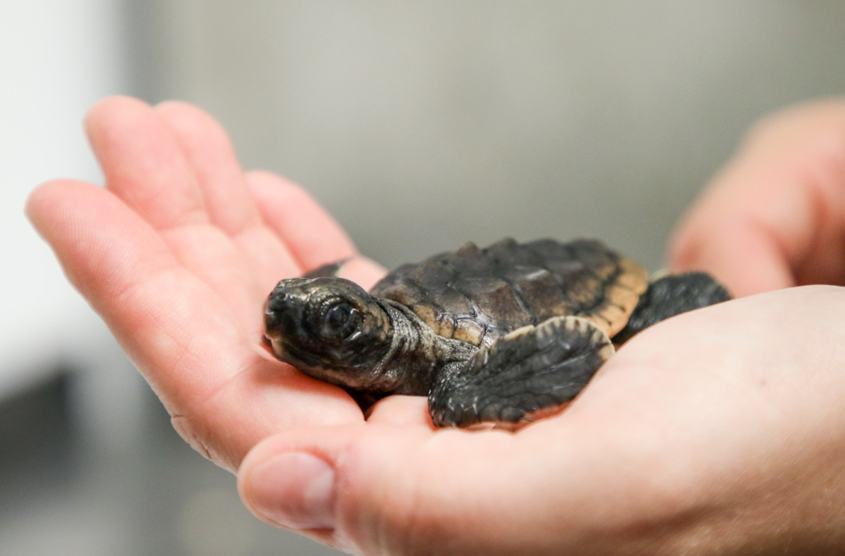
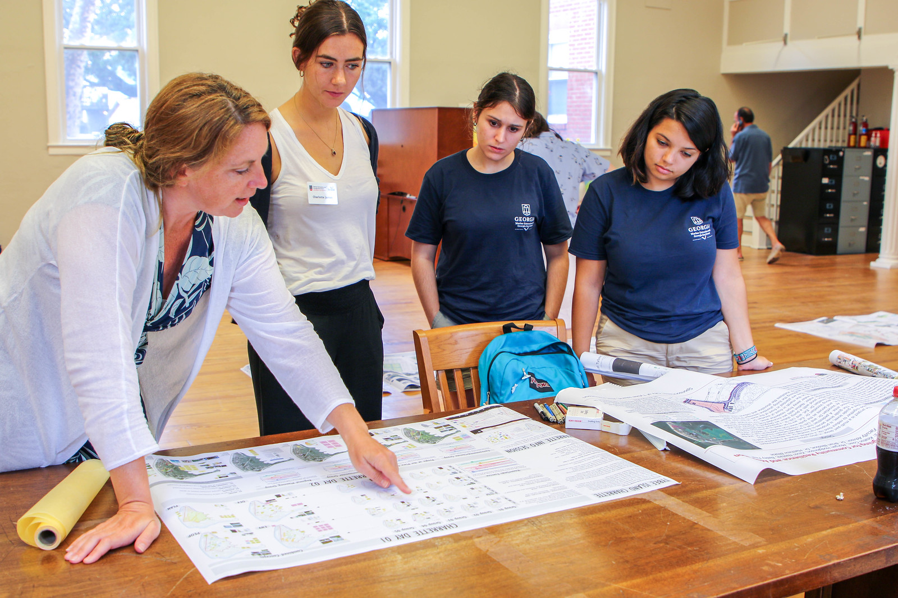
COLLECTING ENVIRONMENTAL DATA
Monitoring the environment allows scientists to observe changes in environmental conditions over time. Environmental data helps us:
Understand Weather Impacts
Protect Wildlife
Plan for the Future
Notes:
Scientists collect long-term data to identify trends or changes over time at a given place. This helps us understand the impacts of development, environmental changes, or impacts to the environmental quality of an area.
It is important to understand changes so our communities can be as resilient as possible in the face of natural and manmade disasters.

Slide 4
WHY COLLECT WETLAND DATA?
The salt marsh supports biodiversity, which means many different species coexisting in the same environment.
Notes:
https://blog.wfsu.org/blog-coastal-health/2012/09/four-ways-and-more-that-salt-marshes-earn-their-keep/

Slide 5
The salt marsh also provides many ecosystem services, which are things nature offers for FREE!
Examples include food, clean water, flood control, wildlife habitat, recreation, and much more.

Slide 6
An important ecosystem service the salt marsh provides is to act as a "shield" protecting coastal areas from the impacts of extreme weather and flooding.

Slide 7
UNDISTURBED WETLAND
When a wetland is natural and undisturbed, it can function at its full potential, providing ecosystem services to surrounding communities.

Slide 8
IMPAIRED WETLAND
When human activities pollute or alter a wetland, it may become less able to provide ecosystem services and protect communities against natural hazards.

Slide 9
WHAT ARE NATURAL HAZARDS?
Natural hazards are extreme events that occur naturally and negatively impact life, property, local economies and the environment. These can be categorized as either shocks or stressors.

Slide 10
SHOCKS
STRESSORS
RESILIENCE
A sudden, one-time event that impacts the vulnerability of a system.
----------------------------
Hurricanes
Severe storms
Drought
Wildfires
Flooding
Earthquakes
Slow changes that occur over a long period of time and cause a system or community to shift.
-------------------------------
Sea level rise
Harmful algal blooms
Erosion
Rising temperatures
Habitat loss
Pollution (air, water, soil)
The ability to manage shocks and stressors and be able to "bounce back" after an event.
-------------------------------
Education
Preparedness
Green infrastructure
Living shorelines
Relocating from a high-risk area

Slide 11
What are other ways communities can be more resilient?
NATURAL INFRASTRUCTURE
LONG-TERM MONITORING
Natural infrastructure is an engineering practice that mimics nature in the construction of buildings, roads and other essential parts of a community while maintaining nature's ecological processes.
Long-term monitoring helps us understand whether a wetland system is healthy or impacted. An impaired system may lose its ability to protect communities from shocks and stressors.
See Extension on last slide for additional information on Natural Infrastructure.
Notes:
In order to identify the highest need for restoration efforts/green infrastructure, scientists use data collected from wetland sites over long periods of time. This helps understand if an otherwise healthy system has become impacted or is not working to it's fullest potential.

Slide 12
TECHNIQUES FOR LONG-TERM MONITORING
Visual Surveys
Making observations about the environment that may indicate impairment.
Examples: water appearance, stormwater pipes
Biological Surveys
Collecting data about organisms living in the ecosystem.
Examples: plant and animal identification
Physical Surveys
Collecting data about abiotic factors that characterize the environment.
Examples: salinity, dissolved oxygen, temperature

Slide 13
UNDERSTANDING COASTAL CHANGE
Almost 40% of the U.S. population lives along the coast. Development is a human activity that can impact a wetland's ability to protect coastal communities from natural hazards, like flooding.
With 25% of coastal land being developed twice as fast as the rest of the country, it is important to conserve nature's benefits when planning for population growth and future needs.
When monitoring the salt marsh and other wetland areas, you may observe natural features, like vegetation, water, soil and wildlife, as well as evidence of human impact, like roadways, bridges, pollution or debris.

Slide 14
TAKEAWAYS
Long-term monitoring provides a record of past and present conditions in an area.
Extreme weather can harm natural habitats, structures, like buildings and homes, and threaten livelihoods and lives.
Wetlands provide a natural buffer and absorb storm surge to help protect coastal communities.
Understanding coastal wetland health can help communities plan and adapt for the future.

Slide 15
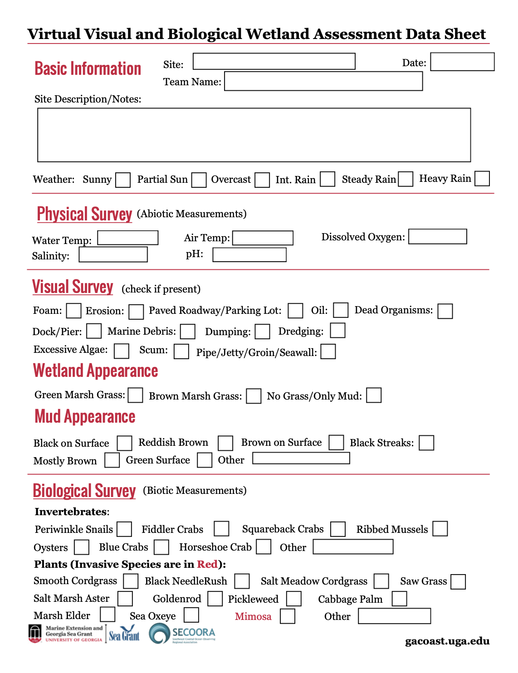
ACTIVITY
Using what you have learned, you will now get to conduct your own physical, visual and biological surveys of a virtual wetland site.
Visit the main curriculum web page for instructions.
Notes:
Lets practice data collection

Slide 16
EXTENSION:
1. Buffers storm surge 6. Protects wildlife habitat
2. Improves water quality 7. Promotes a healthy lifestyle
3. Reduces erosion 8. Is aesthetically pleasing
4. Adds a little green to the gray 9. Improves the economy
5. Protects upland property 10. Allows everyone to participate
VIEW WEBSITE & TOP TEN HANDOUT HERE:
https://coast.noaa.gov/states/fast-facts/natural-infrastructure.html

